Slide 1
Sequence alignment
Cs2004 – Design and analysis of algorithms
Muthu Palaniappan M

Slide 2
Sequence alignment
Sequence – string of letters
Sequence alignment – Is a way of arranging two or more sequences of characters to identity regions of similarity.
Types of sequence in Bio-Informatics – 1) DNA sequence 2) RNA sequence 3) Protein Sequence.
Alignment – Arranging the sequence of DNA/RNA or Protein to identify similarities.
Types of Alignment – 1) Global Sequence 2) Local Sequence
Global Sequence: Two Sequence are of same length with significant degree of similarity throughout.
Local Sequence: Two Sequence are of different length and least degree of similarity throughout.

Slide 3
Goals of sequence alignment
Global Sequence: Needleman-Wunch Algorithm
Local Sequence: Smith-Waterman Algorithm
These two dynamic programming alignment algorithm are guaranteed to produce a OPTIMAL alignment.
Goals of Sequence Alignment:
Measure the similarity.
Infer Evolutionary relationships.
Observe biological patterns and variability of sequences over the period of time.

Slide 4


Why dynamic programming?
Even for relatively short sequences , there are lots of possible alignments. There are two approaches to solve these problem
Brute-Force approach
Dynamic Programming.
Brute-Force Approach
Generate the list of all possible alignments between two sequences and finds the alignment with the best score.
The number of possible alignments between two sequence of length N is
Take time proportional to

Slide 5

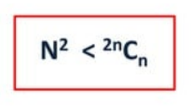
Why dynamic programming?
Dynamic Programming – Needleman Wunch Algorithm
The Needleman Wunch Algorithm save us the trouble of assessing all the many possible alignments to find out the best one.
Produces optimal solutions.
Takes time proportional to
Performance
N-W is much faster than assessing all possible alignment one-by-one.

Slide 6
Needleman-Wunsch algorithm
The Needleman-Wunsch algorithm is used in bioinformatics to find out the best alignment of proteins or nucleotides sequences.
It performs the global alignment on two sequences.
It is an example of Dynamic Programming and It was one of the first applications of dynamic programming to compare the biological sequences.
Jerry-Ge/Needleman-Wunsch-Algorithm: Implemented the Needlman-Wunsch algorithm for global pairwise sequence alignment. (github.com)

Slide 7
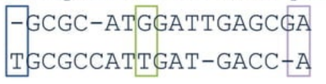
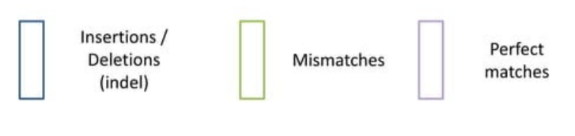
Sequence alignment - results
Input: Two sequence over the same alphabet
Output: An alignment of two sequences.

Slide 8


N-w Algorithm
To use N-W we must first define the following.
A Scoring Function : Defines the score to give a substitution mutation e.g. 2 for a Match and -1 for Mis-Match
A Gap Penalty : Define the score to give to an insertion and deletion.
A Recurrence Relation : Defines what actions repeat at each step/iteration of the algorithm.

Slide 9


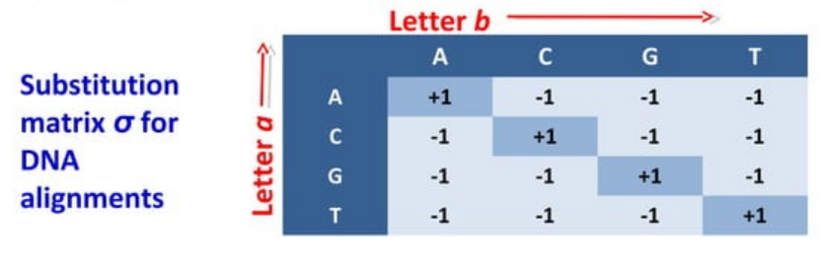
Scoring function
A convenient way of representing many scoring functions is a substitution matrix.
This shows the cost (score) of the alignment of one letter (nucleotide) with another letter (nucleotide).
Picture credits : Dr Avril Coghlan

Slide 10
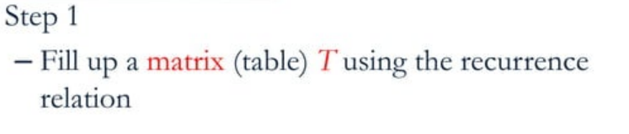
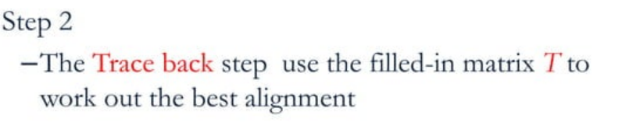
STEPS for N-w

Slide 11
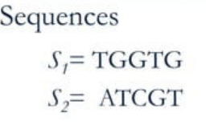
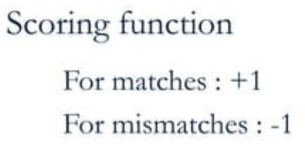

workout

Slide 12
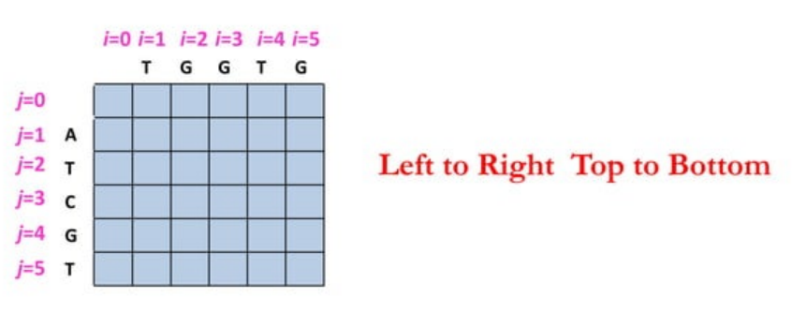
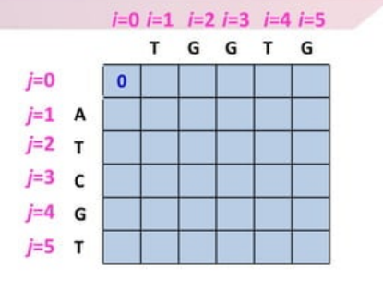
workout
Initializing the table.
Step-1 : The value of T (0,0) is set to zero at the start.

Slide 13
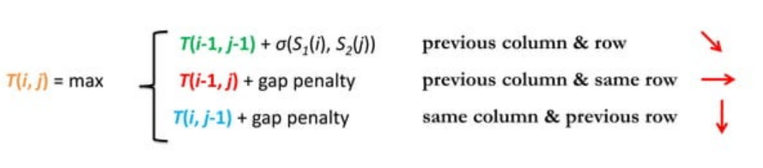
workout

Slide 14
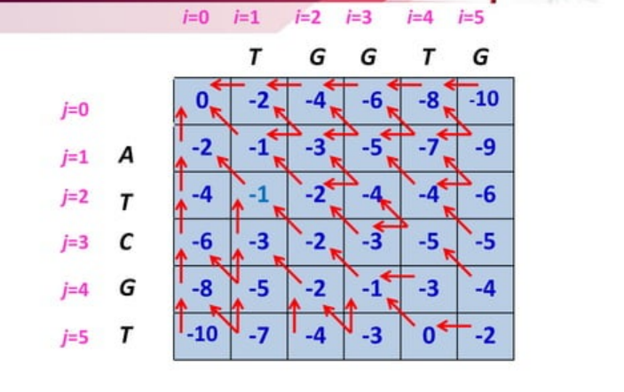
workout

Slide 15
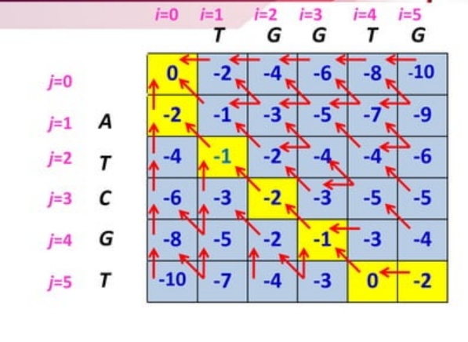
Traceback

Slide 16
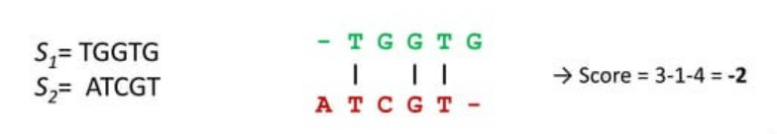
results

